Slide 1

Schooled Web Application
By: Danie Johnston

Slide 2
About
Right Education
Sharing of Knowledge
Community

Slide 3
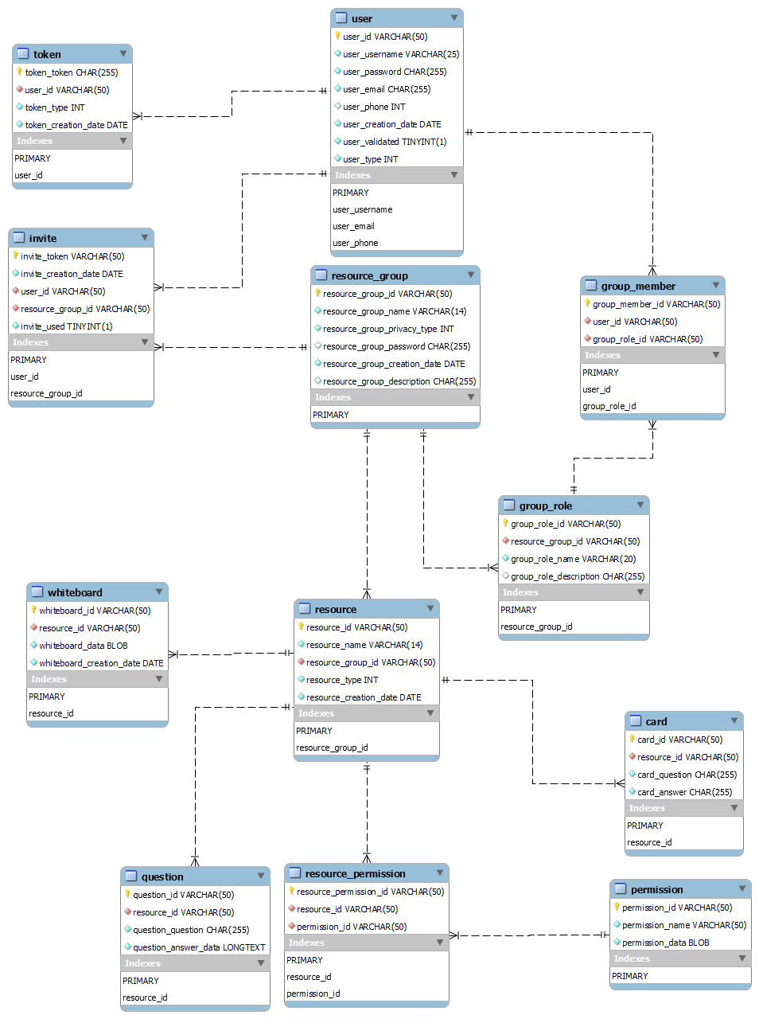
Database Layout
12 Entities
3 Sub-Entities

Slide 4



Application Information
.NET5
MySQL
Angular
Entity Framework Core 5

Slide 5
Application MySQL Queries
14 Queries
5 Entities / 12 Entities

Slide 6
Complex MySQL Queries

Slide 7
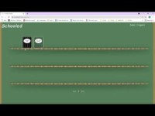
Link: https://youtu.be/Do_foIz2RwI

Slide 8
Future State
Resources
Members
Roles
Sharing of information

Slide 9
Thank You for watching

